Slide 1
Re-Think Mobile… Beyond Mobile-First
August 27, 2015

Slide 2


Craig Mikus, CPA
Sr. Director, Mobile & IoT SC Specialist Team
North America Sales Engineering Team
20+ Years in the Software Industry
Oracle – Sales, M&A, Bus Dev, Enablement
Corporate - Finance, Data Warehousing
Public Accounting – Audit
Anirban Bagchi
Principle Sales Specialist, Mobile & IoT
12+ Years in IT Industry
Oracle – Sales Consulting in India and US
Middleware and Mobility Solution Architect

Slide 3

Topics for Discussions
1
Mobile – Enterprise Evolution (or Revolution?)
Challenges and Trends
Enterprise Mobility
Emergence of the MBaaS
Oracle /Demo
Q&A
2
3
4
5
6
Notes:
Main Points: Mobile and specifically enterprise mobility topic continues to be the topic on everyone’s mind. In today’s session and Mobile track we will go through the following agenda sections:
Transform The Enterprise – discuss how mobile is playing a key role in the digital and or mobile transformations across industries, with organizations large and small around the world
Rethink Mobile – discuss what we have learned especially in the past decade and discuss why it is time to Rethink Mobile … and look to thinking beyond having a Mobile-first strategy,
Simplify Enterprise Mobility – discuss Oracle Mobile’s core value proposition and strategy to simplify enterprise mobility.
In the Future… What next? – discuss where we are going … how Oracle is continuing to invest in mobile platform to simplify enterprise mobility
Let’s get started.

Slide 4









The Enterprise Evolution (or Revolution?)
The New Normal
Mainframe
Client/Server
Web
Mobile
Things
Notes:
Main Points:
Over last few decades, with maturity of internet, IT has evolved from predominantly mainframe and client/server dominated environment to a much more open web based environment. And more recently with the dramatic increased in capabilities and adoptions of smartphones, and tablets -- mobility has become a critical part of IT environment.
But mobility does not stop with devices we are already seeing much more -- the power of mobility extended from devices to things – e.g. smart forks, refrigerators, TV, vehicles, and other devices that allows users as well as machine to interact with enterprise IT. More and more of these integrations and apps will be delivered through cloud services. Enterprises will soon need to evolve to the connected enterprise. Customers, partners, and employees are expecting to get things done intuitive via any device at anytime, anywhere. IT need to have a robust, open, and agile environment to support this.

Slide 5

Re-Think Mobile: Beyond Mobile First
Challenges:
Trends:
Mobile App(s)
Rapid Development/Velocity
Enterprise Security & Integration
TCO (Total Cost of Ownership)
MBaaS (Independent from SOR)
IoT & Big Data
Controls & Governance
Mobile as an Architecture
“Old Things, New Ways”
(Evolution)”
Transformation
“New Things, New Ways”
(Revolution?)
Enterprise Mobility
Notes:
What I plan to cover this morning is share with you how mobile is playing a key role in the digital transformation, lessons we have learnt, our strategy at Oracle to simplify enterprise mobility and our investment in product and technology that is going to help you invent the future.

Slide 6
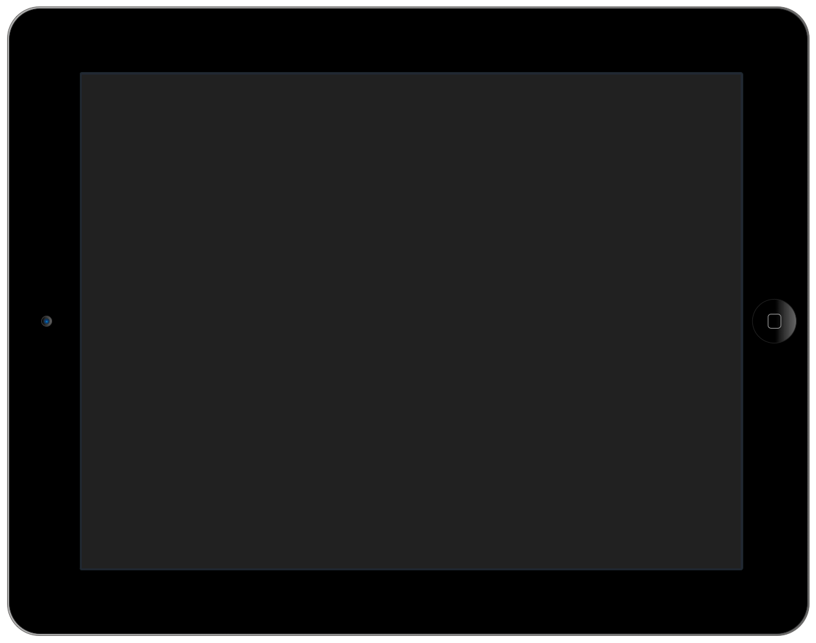
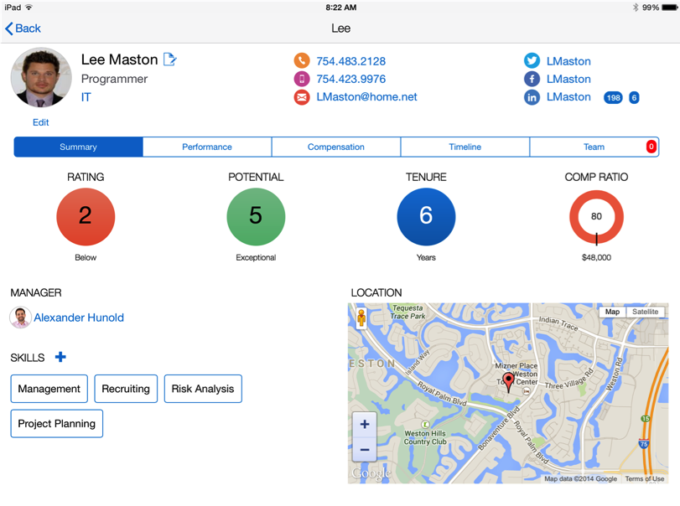
Beyond Mobile First ....
Let’s start with a simple Mobile App – An HR App
Notes:
Speaker’s Notes –
In order to explain what MCS is, let us first take a look at why we wanted to build MCS from the outside – in.
Imagine that as a mobile developer you were asked to build a mobile app that looked like this – a very simple, elegant HR mobile designed for the HR rep or a manger to use. This screen in this looks relatively simple and has all the data the user needs about their employee.
It has information about the employee, their contact details, their social networking information, their performance information, talent management information, their location etc.
Overall we would all agree this looks like a simple app.

Slide 7
And Map It To The Systems Of Record (SOR)
Core HR, PeopleSoft, SAP On premise
MCS Storage
Social Networks Twitter, Facebook, LinkedIn Web
Talent Management Taleo Cloud
Core HR, PeopleSoft, SAP On premise
Core HR
Map Service Google Web
Talent Management Taleo Cloud
Notes:
But as we map the data back to the systems of record we quickly can understand the complexity behind any “simple” mobile app. That fact is - this simple app is quite complex in that you need to integrate data from multiple systems of record. For e.g. let’s say the HR systems were different based by geo – on premise (SAP in Europe and Oracle PeopleSoft in US), the talent information came from Taelo – a SaaS app Social networking came from LinkedIn, FB and Twitter. Mapping service from Google. This enterprise wants to store employee photo but the backends may not be set up for storing images.
While creating the front end is a relative easy task trying to integrate this data, map user identity and security policies and getting different APIs together is what takes the longest time

Slide 8














This Simple App Soon Became Complicated .. Quickly
Multiple
Environments
Client Dev
Tools
Monitor &
Analyze
Security
Mobile
Services
Integration
Notes:
So now it is up to the mobile app developer to think about many different things as they consider how to build and engaging mobile app. For example:
What tool will they use to build the mobile, native or cross platform ?
How do they integrate to these multiple systems of record – 7 in this case
What are the user identity policies for these backend systems. They may be different based on the authentication policy of the backend
IT would need to provide environments for dev, test and prod – multiple environments since the app is not static and will have continuous development
What about adding mobile services like the ability to work in an offline mode, to get push notifications, add geo coding to the employee record
What about diagnostics, analytics to determine how the app is performing, who is using the app etc
In summary, there is a lot that goes on in building a mobile app. Building the UI becomes the easy part. The hard part is managing all these other areas.

Slide 9















The Roles involved to build an Enterprise Mobile App ...
Sys Admins
CSO
OLTP
Core HR, PeopleSoft, SAP On premise
Talent Management Taleo Cloud
ETL
Architects
Analysis / Reporting
DW / Data Marts
Data Reservoirs
Data Lakes
Data Modeler
Front End Designer
API Developers
External Feeds
Social Networks Twitter, Facebook, LinkedIn Web
CIO
App Dev Lead
Mobile Lead
Map Service Google Web
Business Requestor

Slide 10
Simplify Enterprise Mobility
Build & Deliver Mobile Apps with Seamless, Secure Access to Mission-Critical Data
Custom Mobile Apps
Packaged Mobile Apps
Partner Built Mobile Apps
Develop
Build engaging user experiences
Develop once, run anywhere
Connect
Reduce cost and drive efficiency
Simplify integration & user management
Manage
Cloud-based lifecycle management
Analyze
Measure app performance and adoption
Improve release velocity and monitor apps
Secure
Prevent leakage of corporate data
Secure personal and business devices
Notes:
Speaker’s Notes:
Oracle’s Mobile Portfolio provides a complete end to end solution that manages the entire mobile lifecycle. The key tenants to Oracle’s mobile solution is to provide a platform that allows customers to develop, connect, secure, analyze and a manage their mobile applications. With our platform customers, can build customer apps or use and or extend our 100’s of packaged mobile apps.
With Mobile Cloud Service ( which now together with Mobile Application framework) we provide all the capabilities needed to build, connect, secure, analyze and manage mobile apps wuickly and efficiently. We provide Mobile Security Suite which not only is integrated with MAF/MCS but also tightly integrated with our IDM Suite – is an integral part of our Mobile offering but also can be de-coupled and used as part of a broader enterprise security initiative.
Finally Oracle and our partners continue to provide standalone out of the Mobile apps across our on premises and Cloud offerings.

Slide 11





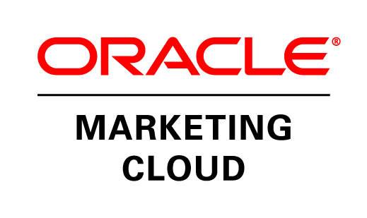
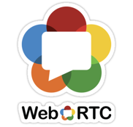


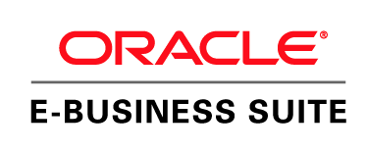

Why MBaaS???
Front End Mobility ← → Back End Mobility
Multi-channel Front Ends
Lots of Back Ends
Mobile API Mgt & Rpting
Push Notification
Offline
Sync
Analytics
User Mgt
Diagnostics
Storage
Custom API’s
Connectors
Internet Services
Enterprise Systems On Premise / Cloud
Notes:
Speaker’s Notes: (Option slide – may not be needed if using previous slides)
Indeed there are lots of mobile front ends – in Oracle’s vision M is not just mobile but Multi-channel – so we embrace wearables, nearables, Nest thermostats and connected cars etc.
And there are lots and lots of backends …. Legacy applications more SaaS and multitude of internet backends including Twilio for messaging webRTC for teal time video.
The focus here is on the mobile app developer – to make it as easy as possible to access these backends and access them and use the data in the mobile app.
The task of the mobile platform is to “Normalise” the access and date from the backends – to make them consistent and easily accessible. This allows information and function from different sources to be blended together to form richer services. The data from the backends can be shaped – transforming it to make more accessible, enriching it with data and making suitable for delivery over an air interface.
And lastly and not least using the data from the apps – context, user behavior, diagnostics to form powerful mobile analytics.

Slide 12









DEVICES AND SERVICES
CLOUD SERVICES
MBaaS
CLOUD SERVICES
Integration Service
Process Service
Security Service
Database Service
Keys to Success
CORPORATE NETWORK AND SYSTEMS OF RECORD
INTEGRATION
PROCESS
DATA

Slide 13
Q
Anirban
&
Craig
A
Notes:
Speaker’s Notes: Oracle Mobile Cloud Service delivers real value for key stakeholders within the enterprise.
The Mobile Developer – who is interested in building the best mobile experience in their mobile apps. For them MCS provides access to mobile API catalog and SDK that allows them to easily connect to various system.
The Service Developers -- that typically focus on providing secure access to various enterprise systems can publish their mobile ready service to the API catalog.
The business technologist or manager can leverage the mobile analytics and dashboards to gain insight, monitor and analyze the success or performance of their mobile apps.

Slide 14

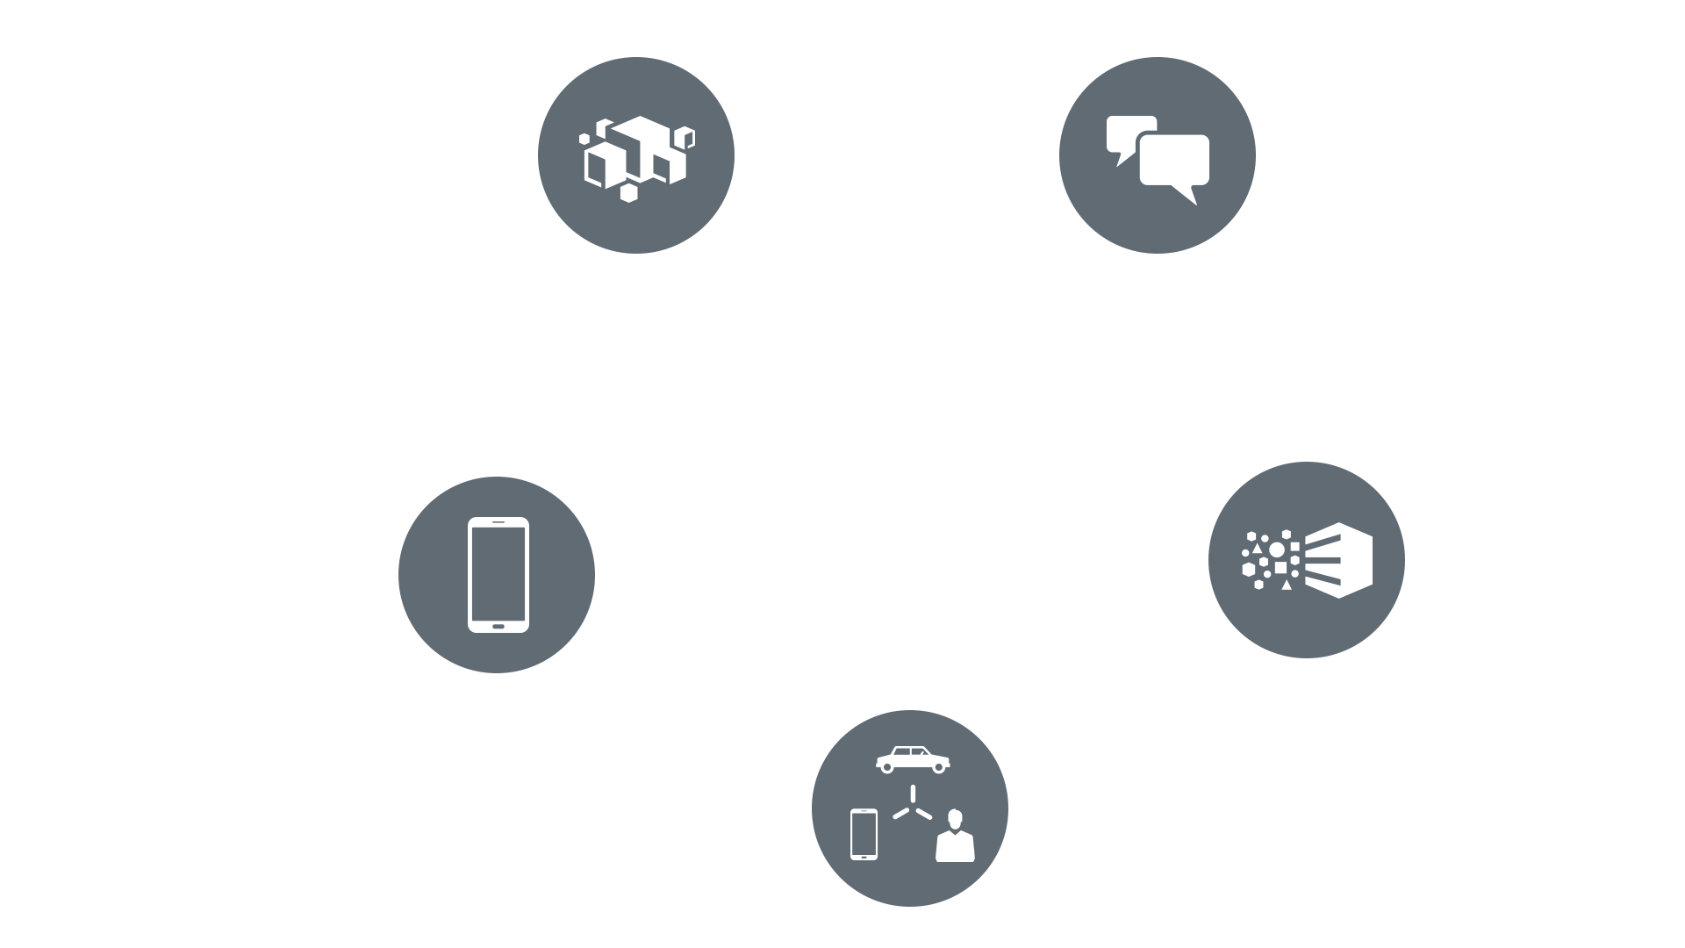

Oracle Key Strategies
Mobile
Cloud
Information
(Big Data & IoT)
Social
Notes:
It is the combination of these technologies that will allow each one to reach its full potential. Additionally, the ongoing maturation in the enterprise adoption of earlier waves of technology such as SOA, BPM, Components-off-the-Shelf, API management & web services and data warehousing provide an important foundation to the success of this next phase.

Slide 15
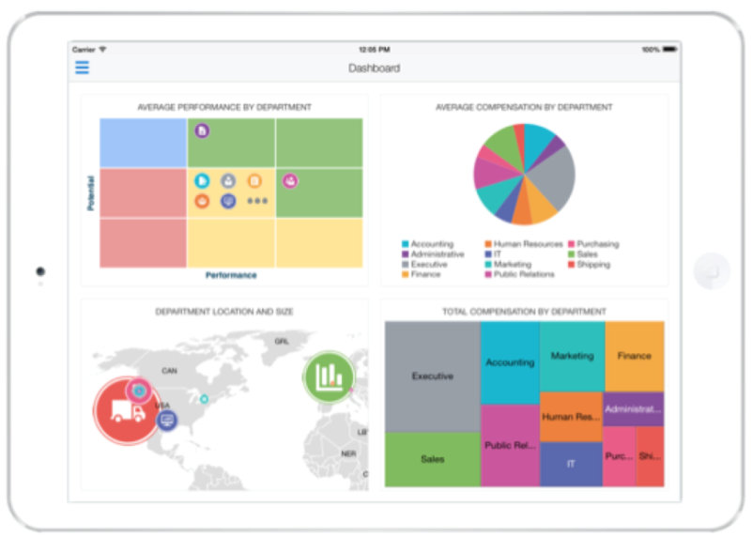
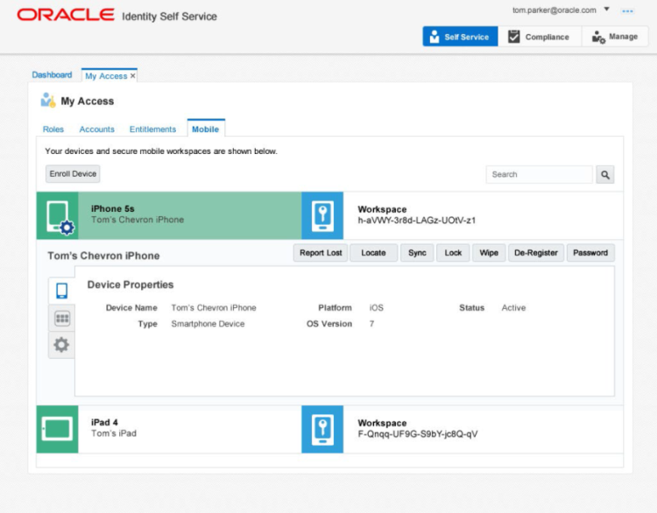
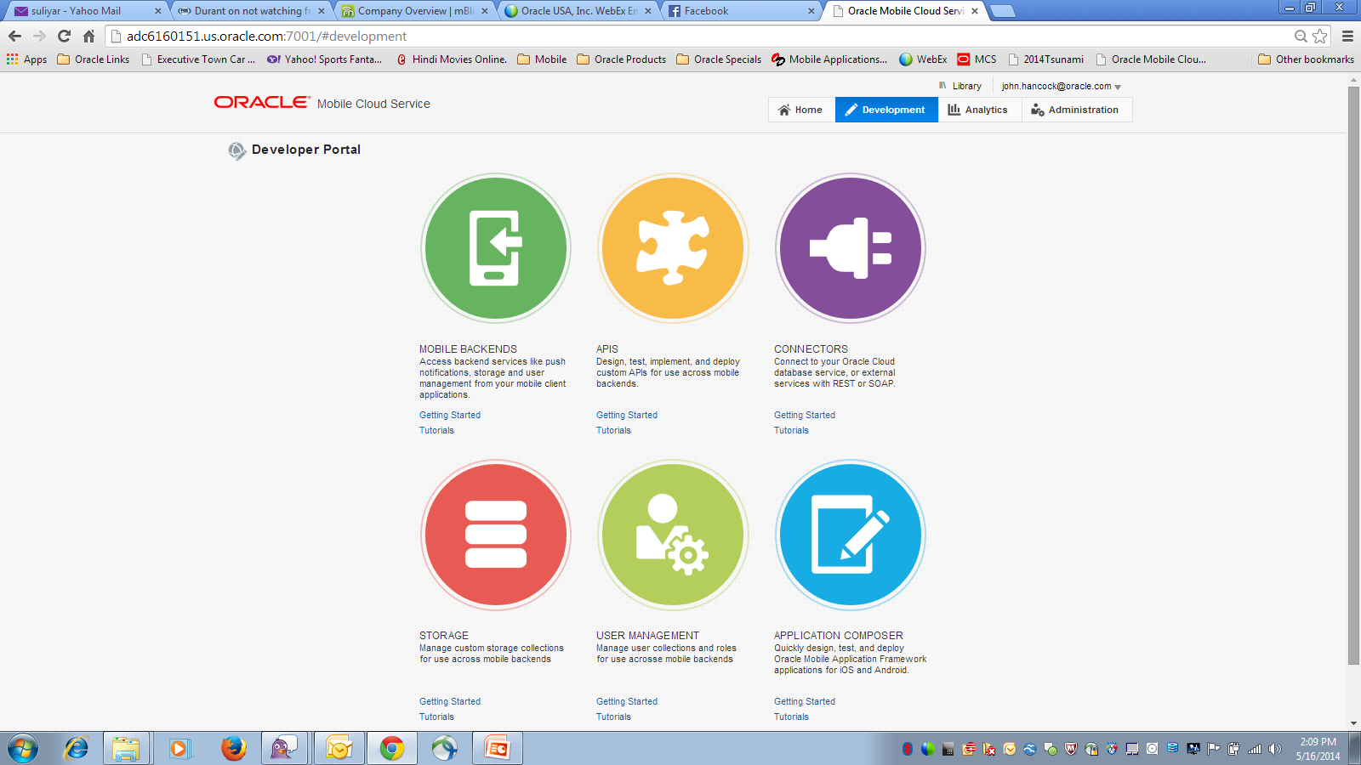
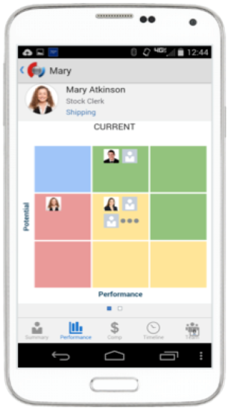
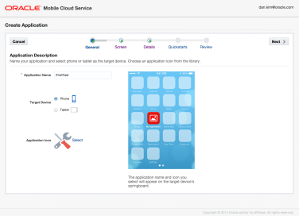
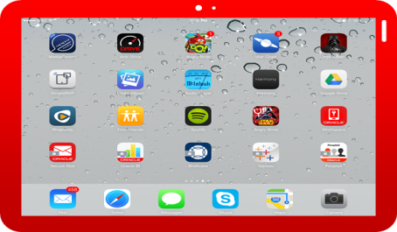
Oracle Mobile Strategy
Develop, Connect, Manage, Analyze, Secure, & Deploy
Develop
Connect, Manage, Integrate, Analyze
Manage, Secure & Manage
Mobile Application Framework
Mobile Cloud Service
Mobile Security
Notes:
Explain Oracle mobile strategy to Hershey

Slide 16
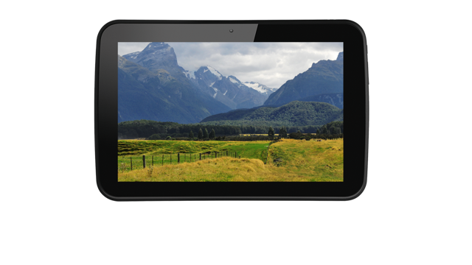
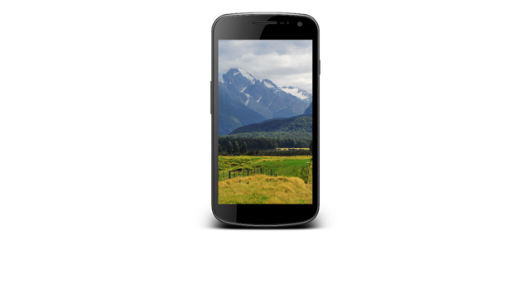
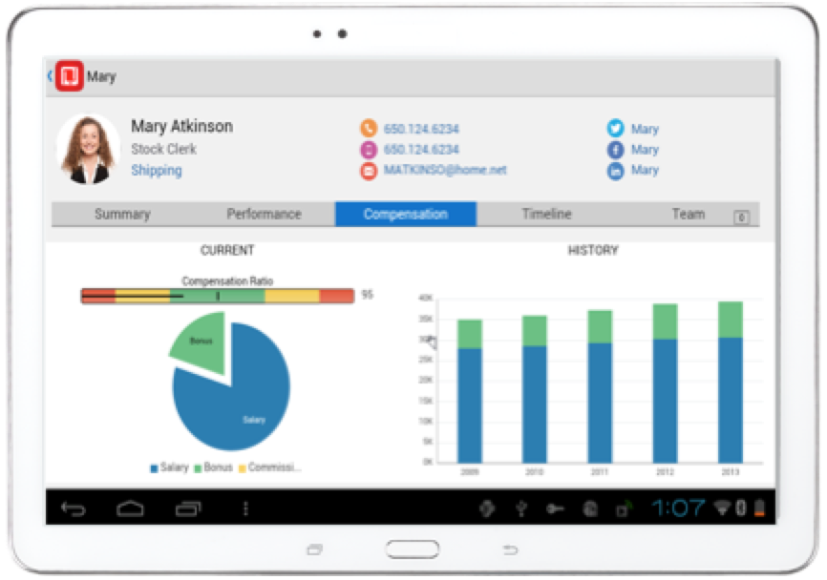


Develop - Oracle Mobile Application Framework
Productivity Boosting Framework
Build Once, Run on Multiple-Platforms
Cordova Extendable Framework
Simpler Component based UI development
Java / JavaScript for business logic
Integrated Security
Full Access to Native Device Features
Modular, Reusable Application Components
Offline Storage: SQLite with Encryption
Notes:
Main Point: Included as part of Mobile Cloud Service and also separately is another major component of Oracle’s Mobile Platform – Oracle Mobile Application Framework. It provides the development framework that is designed to boost productivity:
To develop mobile apps – Organizations can leverage the Mobile Application Framework, the only java framework designed to support cross platform development:
It enables developers to build a mobile app and being able to deploy it onto multiple devices, iOS, Android and on different form factors – oracle will be responsible for keep up with the changes in the mobile OS. Of course, we are also watching the other platform as the requirement for these increase we will support other operative systems.
The app is build with consistent business logic and data model, it can be native or HTML 5 with full access to native device feature. This allows you to leverage existing skill among your developers, any one with Java based skill set, can now build mobile apps.
It also leverage SQL-lite to support disconnected processes with built-in encryption.
Full Access to Native Device Features
The framework is designed to be modular with re-useable components that can be leveraged to simplify mobile app development.

Slide 17
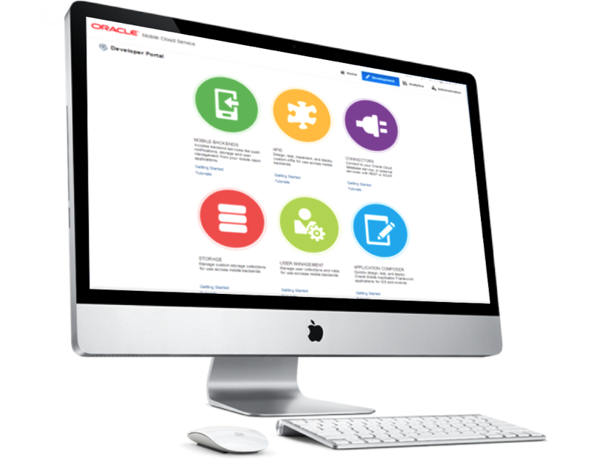
Oracle Mobile Cloud Service
Key capabilities
Built for Mobile
API’s extensible with JavaScript (Node.JS)
Built in Mobile APIs (Sync, Push, User Mgmt..)
Development environment based on persona / role
Enterprise grade security
Client Development Tool Agnostic
Usage & analytics for developers & business owners
Integrated with Oracle’s complete PaaS solution and applications
Notes:
Speaker’s Notes:
The Oracle Mobile Service goal is to easily enable mobile application developers that are continually looking for new ways to accelerate development of apps to meet their consumers’ needs. MCS will be a set of cloud-based, server-side mobile services to make app development quicker and easier to deploy. MCS reduces the complexities of the application development by dealing with the complex server side programming, reducing the redundancy in creating backend code blocks, providing ready to integrate features and template backend.
Developers can focus more on the front end of the applications and can have their choice of mobile client development tools including ADF-Mobile for cross platform hybrid apps, native development or other Javascript tools – creating a new meaning for BYOD – Bring your own development
MCS provides a set of rich RESTFul interfaces for all the operations required by the mobile app that abstracts the backend from the mobile developer. In addition it also provides mobile specific interfaces for notification (multi channel – app, SMS), offline data sync, persistence services (to store mobile generated data and user preferences) as cloud data storage service.
From a backend perspective, MCS provides all the tools required by API developers to expose and shape the services to be consumed by the mobile developer. This includes mechanisms to design, create and expose these services in a catalog that can be easily and securely discoverable by mobile developers and integrated into their app.
Security is a critical component and is designed ground up in the MCS. From tokens to developers to develop and consume APIs to encryption policies for data in rest, data in motion, policies for single sign on and federated authentication across multiple data sources via Oauth or SAML and policies for defining access rights to applications via mobile application management or container technologies are services that will be available in MCS
A key component of MCS is to provide developers, IT and business with metrics on service usage and business impact. MCS will be designed to provide technical metrics, engagement metrics, business metrics along with the monitoring and management of the service.

Slide 18

Oracle Enterprise Mobility Management (EMM)
Secure user identity, app, data and device
Mobile Identity
Mobile Application Management
Identity authentication and authorization
Single sign on across mobile apps
Risk / context aware step up authentication
Self service and delegated administration
Certificate LCM
App centric security policies
Inbuilt PIM apps
Zero code wrapping technology
App store for distribution
Secure apps built on MAF
Mobile Content Management
Mobile Device Management
Secure container & app tunnel for securely accessing and storing corporate content
Strong DLP policies to avoid data leakage
File manager and doc editor / viewer for secure content collaboration
Device centric security policies
Device enrollment
Device control
Device inventory
Notes:
Oracle has an end to end solution for this
Cover this from the perspective of a developer
For CIO’s, security is the #1 concern – with good reason. Mobile is a new channel
Zero Code wrapping- a NO-CODE SOLUTION
You DEVELOP apps as USUAL. No need to write extra code to manage authentication. Manage tokens. Etc.
For mobile identity, plays well with authentication and authorization solutions. Oracle Access Manager, or perhaps Active Directory Services
For a developer, OMSS is a MDM – support for the device centric security policies – leveraging OS specific MDM capabilities in Android and iOS
Secure Container with app tunneling
Strong DLP, Data Loss Prevention policies
For MAF applications, it’s built in.
AppCatalog
Have an exiting MDM solution? Works fine, along side existing MDM like mobile iron.
We will see this industry go through some chaotic moments in the next 12 months with Google, Apple, Microsoft providing more of these MAM / MDM features. This coupled with transition to cloud will make enterprises pause and re-consider their decisions.
On the outset, most customers have deployed some form of mobile device management, but this is still really early days for mobile security. To quote numbers, Mobile Iron’s average revenue per customer was around $17,000. Also, on average, mobile security solutions have less than 50% seat penetration within mid-size companies and even lesser in larger organizations. With Bring Your Own Device growing more employees do not want to use Mobile Device Management (MDM).
Gartner’s prediction for EMM is:
Security with no coding required
Develop as usual, then wrap it with our secure container
MAF and MC integration
Single sign-on, e.g. manage token (kerperos, SAML, etc.) Oracle Access Manager, Microsoft Active Directory (OAUTH)

Slide 19



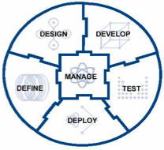



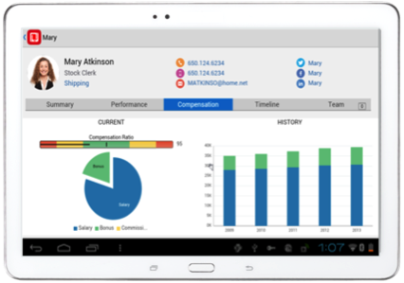




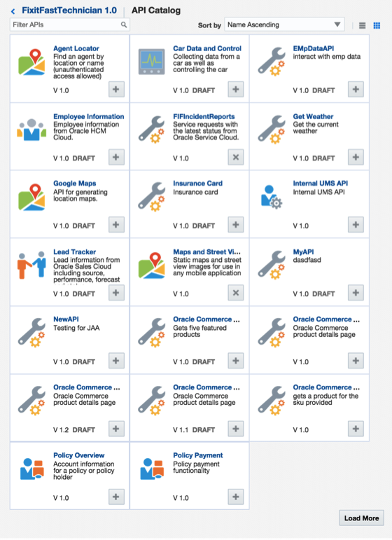








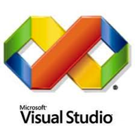



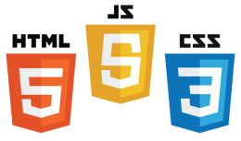





Oracle Mobile Cloud Service
Outside-in, Mobile First
Analytics
Continuous Development
MOBILE APPLICATION FRAMEWORK
Diagnostics
Usage
Engagement
Monitoring
Inside-out, Service first
SDLC
Built-in APIs
Offline Sync
User Mgmt
Native
Mobile
Cloud Service
ICS
OSB / SOA
Cloud
Notifications
Storage
Connectors
Mobile APIs / SDKs
SECURE
Public Cloud
Oracle Cloud
Enterprise SaaS
On-premise
On-Premise Packaged Applications
3rd Party API
Others
Custom API
Users
Data Shaping
Objs
Custom
Logic
Orchestrate
CUSTOM Applications
19
Notes:
The Oracle Mobile Service goal is to easily enable mobile application developers that are continually looking for new ways to accelerate development of apps to meet their consumers’ needs. MCS is a set of cloud-based, server-side mobile services to make app development quicker and easier to deploy. MCS reduces the complexities of the application development by dealing with the complex server side programming, reducing the redundancy in creating backend code blocks, providing ready to integrate features and template backend.
Developers can focus more on the front end of the applications and can have their choice of mobile client development tools including ADF-Mobile for cross platform hybrid apps, native development or other Javascript tools – creating a new meaning for BYOD – Bring your own development
MCS provides a set of rich RESTFul interfaces for all the operations required by the mobile app that abstracts the backend from the mobile developer. In addition it also provides mobile specific interfaces for notification (multi channel – app, SMS), offline data sync, persistence services (to store mobile generated data and user preferences) as cloud data storage service.
From a backend perspective, MCS provides all the tools required by API developers to expose and shape the services to be consumed by the mobile developer. This includes mechanisms to design, create and expose these services in a catalog that can be easily and securely discoverable by mobile developers and integrated into their app.
Security is a critical component and is designed ground up in the MCS. From tokens to developers to develop and consume APIs to encryption policies for data in rest, data in motion, policies for single sign on and federated authentication across multiple data sources via Oauth or SAML and policies for defining access rights to applications via mobile application management or container technologies are services that will be available in MCS
A key component of MCS is to provide developers, IT and business with metrics on service usage and business impact. MCS will be designed to provide technical metrics, engagement metrics, business metrics along with the monitoring and management of the service.
MCS designed for flexibility and simplicity.
Mobile clients. Any.
Mobile cloud services, API catalog. Built in mobile services. Push, sync, user management, etc.
Access to 3rd party services. Add rich content consistently.
Oracle is well know for integration and SOA, bringing that to mobile. Expose these interfaces as mobile-ready APIs.
Built in analytics.

Slide 20
Developers- Persona Based
Mobile Front End Developer
I build the best mobile user experience
Browse and access mobile API catalog
and SDK
Services Developer
I provide access in a secure, scalable, controlled manner
Publish mobile ready services to
API catalog
Mobile Cloud Service
Line of Business Manager
I monitor and analyze the success of the mobile apps
Powerful mobile analytics and dashboards for deep insight to the business
Notes:
Speaker’s Notes: Oracle Mobile Cloud Service delivers real value for key stakeholders within the enterprise.
The Mobile Developer – who is interested in building the best mobile experience in their mobile apps. For them MCS provides access to mobile API catalog and SDK that allows them to easily connect to various system.
The Service Developers -- that typically focus on providing secure access to various enterprise systems can publish their mobile ready service to the API catalog.
The business technologist or manager can leverage the mobile analytics and dashboards to gain insight, monitor and analyze the success or performance of their mobile apps.

Slide 21
Q
Anirban
&
Craig
A
Notes:
Speaker’s Notes: Oracle Mobile Cloud Service delivers real value for key stakeholders within the enterprise.
The Mobile Developer – who is interested in building the best mobile experience in their mobile apps. For them MCS provides access to mobile API catalog and SDK that allows them to easily connect to various system.
The Service Developers -- that typically focus on providing secure access to various enterprise systems can publish their mobile ready service to the API catalog.
The business technologist or manager can leverage the mobile analytics and dashboards to gain insight, monitor and analyze the success or performance of their mobile apps.

Slide 22
DEMO
Mobile
Cloud Service
Mobile CLIENT
JD Edwards
Notes:
Set up and explain the demo. Mobile client connecting to MCS, connecting to a backend system

Slide 23
Q
Anirban
&
Craig
A
Notes:
Speaker’s Notes: Oracle Mobile Cloud Service delivers real value for key stakeholders within the enterprise.
The Mobile Developer – who is interested in building the best mobile experience in their mobile apps. For them MCS provides access to mobile API catalog and SDK that allows them to easily connect to various system.
The Service Developers -- that typically focus on providing secure access to various enterprise systems can publish their mobile ready service to the API catalog.
The business technologist or manager can leverage the mobile analytics and dashboards to gain insight, monitor and analyze the success or performance of their mobile apps.

Slide 24
Thank You!
Visit: oracle.com/mobile
Or cloud.oracle.com/mobile

Slide 26
Other Slides

Slide 27
Enterprise Mobility Trends
50%
By 2017, companies will spend $189 billion to enable mobile services
- Forrester Research
80%
50%
By 2024, enterprise will deploy between 300 – 1400 mobile apps based on the # of employees
- Gartner Research
80% of enterprises have a backlog of up to 20 – 25 mobile apps
50% of current apps will be re-written
Notes:
Along with Cloud, Mobile is a huge trend in the Enterprise
Job security slide
By 2017, $189B to enable mobile services
More than Oracle!
We know why. It’s the First Screen.
BYOD. Consumerization of IT.
You will be busy.

Slide 28




Enterprise Mobile Challenges
Total Cost Of Ownership
Normalizing mobile parts
Agility & Business partnership
Managing Mobile Portfolio ROI
Business
Time to Market
Customer experience
Actionable insights
Speed of continuous releases
IT
Developers
Architects
IT Security
Mobile Data Loss & Breaches
Application Security
Managing user identity
Content security
Complexity
Multi OS / Multi Device
Mobile App Integration
User identity management
Notes:
In terms of challenges, it’s not just about technology
Business wants mobile. Marketer like me, want to take advantage of mobile
Time to Market = Key
IT leadership tries to meet business needs, while managing costs.
<slide bullets>
Security – that’s the #1 concern – with good reason.
<slide bullets>
For developers, it’s more complex
<slide bullets>
Cost of solution. Ease and speed at which mobile apps can be released.
Managing investment across a portfolio of mobile apps. Helping CIO decide on investment priority and provide visibility into usage and adoption
Keep pace with business needs and changes.
For the LOB
Speed, time to market.
Mobile needs to be easy to use and flexible
LOB owners want KPIs to manage their business and be able to take quick actions – become a connected real time business
For Security
It is not about device management any more. IT is concerned about
Managing user identity across devices, managing application and application data security
Managing content created and shared by the mobile device such as file sharing etc
For developers (client & service developers)
Size, shape, differing and continuous update of of OS and mobile devices. – Challenge cost to develop applications across multiple form factors and OS and the on going support and maintenance of these devices that is rapidly changing every 6 months. Side note – SmartWatches are still in its infancy and even before it becomes a part of the enterprise, there are 5 operating systems for these watches (Pebble OS (Linux based), Android One, Tizen (Samsung), Apple and now MSFT). This issue is further exacerbated by the bring your own device (BYOD) where the enterprise has to support employee devices and cannot dictate which device to bring if they support this policy
Integration – 90% of the cost of any mobile app development is attributed directly to enterprise integration tasks. Mobile client development (i.e. the font end) has become easier over time but the complexity of integration has increased. Many enterprises are supporting a cloud & On Premise architecture for their applications (e.g. HCM / CRM on the cloud & ERP on premise). In addition true value of mobile and a rich user experience is achieved when mobile data sources is added such as geo location, social, payment, collaboration etc which makes integration that much more complex
Enterprises are beginning to adopt a much more agile methodology in the way consumer apps are being constantly updated in the app store. While the client side app can go through rapid iteration, enterprise’s face the challenge with their backend infrastructure unable to keep pace with the client front end changes.
----- Meeting Notes (8/21/15 12:19) -----
no man is an island

Slide 29
Oracle Mobile Cloud Service
Business Drivers
I build for the best mobile user experience.
Speed Innovation & Agility: Keep pace with business needs & keeps business competitive
Reduce Cost: Reduce cost & scale as business needs grow
Personalize Engagements: Measure, analyze, engage and increase mobile ROI
Simplify Enterprise Mobility: Easily & securely connect mobile app to enterprise backend services
Mobile Developer
I provide access in a secure, scalable, controlled manner.
Services Developer
Mobile
Cloud Service
I monitor and analyze the success of the mobile apps
Business STAKEHOLDER
Notes:
Speaker’s Notes:
Mobile Cloud service is designed for multiple roles within any organization. The Mobile developer can use it to develop their mobile apps, The service developer can use it to process access in the secure, scalable manager, and finally the business stakeholder can monitor and analyze the success of the mobile apps.
Oracle Mobile Cloud Services offers the complete set of services needed to:
Speed innovation and agility –
keep pace with business needs and mobile app client development,
Add mobile centric features – push, sync, storage, diagnostics, analytics,
Get insights into Mobile Portfolio ROI
Reduce cost –
Reduce risk of mobile connectivity into enterprise data centers
Get insights into Mobile Portfolio ROI
Simplify Enterprise Mobility:
easily connect mobile app to enterprise backend services & security
Hire less experienced mobile developers and enable them with enterprise grade services
Increase mobile adoption and personalize engagement

Slide 30

The Mobile Products are just the Tip of the Iceberg
Mobile Products
Enterprise Mobility

Slide 31

Low Mobile Penetration Enterprise Wide
Active Research/On Radar
33%
19%
Piloting
23%
In production by division
33%
10%
In production enterprise-wide
6%
Upgrading
33%
9%
Not interested
Source: CIO Magazine Tech Poll/Tech . 2014
Sources: Unisys Security Index | Acuity Market Intelligence | MeMD.me Infographic

